Slide 1
CHAPTER 3
SUPERVISED LEARNING NETWORK
Computer Science and Engineering, VJCET, Vazhakulam

Slide 2
LAYERS IN NEURAL NETWORK
The input layer:
    Introduces input values into the network.
    No activation function or other processing.
The hidden layer(s):
    Performs classification of features.
    Two hidden layers are sufficient to solve any problem.
    Features imply more layers may be better.
The output layer:
    Functionally is just like the hidden layers.
    Outputs are passed on to the world outside the neural network.
Computer Science and Engineering, VJCET, Vazhakulam

Slide 3
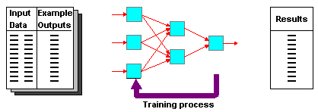
DEFINITION OF SUPERVISED LEARNING NETWORKS
  Training and test data sets
  Training set; input & target are specified
Computer Science and Engineering, VJCET, Vazhakulam

Slide 4
PERCEPTRON NETWORKS
Single layer feed forward network
First neural network learning model in the 1960’s
Simple and limited (single layer models)
Basic concepts are similar for multi-layer models so this is a good learning tool
Still used in many current applications (modems, etc.)
Called Simple perceptron
Discovered by Block in 1962
Computer Science and Engineering, VJCET, Vazhakulam

Slide 5
PERCEPTRON NETWORKS
Key points to be noted in perceptron network are
  Consist of 3 units
    Sensory unit(input unit)
    Associator Unit(hidden unit)
    Response unit(output unit)
  Sensory units are connected to associator unit with a fixed weight having values 1, 0 or -1 which are assigned at random
  Binary activation functions are used in the sensory unit and associator unit
  The response unit has an activation of 1,0 or -1
  The binary step with fixed threshold θ is used as an activation for associator
  The output signal that are send from the associator to response are only binary
Computer Science and Engineering, VJCET, Vazhakulam

Slide 6
The output of perceptron network is given by
Y= f(y_{in})
Where f(y_{in}) is the activation function and is defined as
f(y_{in})=
The perceptron learning rule is used in the weight updation between the associator unit and the response unit
For each training input, the net will calculate the response and it will determine whether or not an error has occurred
The error calculations are based on the comparison of values for targets with those of calculated output
1 If y_{in} > θ
0 If - θ <=y_{in} <= θ
1 If y_{in} < - θ
Computer Science and Engineering, VJCET, Vazhakulam

Slide 7
The weight s on the connection from the unit that send the non zero signal will get adjusted suitably
Weight will be adjusted on the bias of the learning rule if an error has occurred for a particular training pattern
wi(new)=wi(old) +α t xi
b(new)=b(old) + α t
If no error occurred then no weight updation and hence the training process may be stopped
In the above equation the target value ‘t’ is +1 or -1
α is the learning rate
Computer Science and Engineering, VJCET, Vazhakulam

Slide 8
Output 0 or 1
Output 0 or 1
Desired Output
X1
w11
Y1
y1
t1
Y1
w12
Fixed weight value of 0,1,-1 at random
w21
e1
X2
w22
Y2
y2
t2
Y2
w1n
x1
e2
X | X | X
 | X
 | X
x2
w2n
xn
wn1
wn2
Xn
wnn
Yn
ym
Y2
tn
Sensory unit
Sensory grid representing any pattern
en
Associator Unit
Response Unit
Computer Science and Engineering, VJCET, Vazhakulam

Slide 9
Sensory unit
  can be a 2D matrix of 400 photo detectors
  These detectors provide a binary electrical signal if the input signal is found to exceed a certain value of threshold
  Also these detectors are connected randomly with the associator unit
Associator unit
  consist of a set of sub circuits called feature predicates
    Hardwired to detect the specific feature of a pattern
  For a particular feature each predicate is examined with a few or all of the responses of sensory unit
  The result from these predicate unit is also binary
Response Unit
  Contain pattern recognizer or perceptron
  The weight present in the input layer are all fixed
  While weight in the response layer are trainable
Computer Science and Engineering, VJCET, Vazhakulam

Slide 10
LEARNING ALGORITHM
Epoch : Presentation of the entire training set to the neural network.
In the case of the AND function, an epoch consists of four sets of inputs being presented to the network (i.e. [0,0], [0,1], [1,0], [1,1]).
Error: The error value is the amount by which the value output by the network differs from the target value. For example, if we required the network to output 0 and it outputs 1, then Error = -1.
Computer Science and Engineering, VJCET, Vazhakulam

Slide 11
PERCEPTRON LEARNING RULE
In learning rule, the learning signal is the difference between the desired and actual response of the neuron
Learning rule explained as follows
  Consider a finite ‘n’ number of input training vectors, with their associated target values x(n) and t(n), where n ranges from 1 to n
  The target is either +1 or -1
  The output y is obtained on the basis of the net input calculated and activation function being applied over the net input
1 If y_{in} > θ
1 If y_{in} > θ
1 If y_{in} > θ
1 If y_{in} > θ
1 If y_{in} > θ
y=f(y_{in})=
y=f(y_{in})=
y=f(y_{in})=
0 If - θ <=y_{in} <= θ
0 If - θ <=y_{in} <= θ
0 If - θ <=y_{in} <= θ
0 If - θ <=y_{in} <= θ
0 If - θ <=y_{in} <= θ
-1 If y_{in} < - θ
-1 If y_{in} < - θ
-1 If y_{in} < - θ
-1 If y_{in} < - θ
Computer Science and Engineering, VJCET, Vazhakulam

Slide 12
Weight updation in case of perceptron learning is as shown
  If y ≠ t then
  w(new)= w(old)+α t x (α learning rate)
  Else we have
  w(new)= w(old)
Weight can be intialized to any values in this method
Perceptron rule convergence theorom states that
  ”If there is a weight vector W , such that f ( x ( n ) W )= t(n) , for all n, then for any starting vector W1, the perceptron learning rule converges to a weight vector that gives the correct response for all training patterns and this learning take place within a finite number of steps provided that the solution exist”
Computer Science and Engineering, VJCET, Vazhakulam

Slide 13
ARCHITECTURE
The output obtained from the associator unit is a binary vector and hence that the output is taken as input signal to the response unit
Here the weight between the sensory unit and associator unit are fixed
Weight between the associator unit and response unit output unit can be adjusted
As a result the discussion of the network is limited to a single portion
Thus associator unit behaves like input unit
Computer Science and Engineering, VJCET, Vazhakulam

Slide 14
x0
1
x1
X1
b
w1
Y
wi
y
xi
Xi
wn
xn
There are n input neuron and one output neuron and a bias
The input layer and output layer are connected through the direct communication link which is associated with weight
The goal of perceptron network is to classify the input pattern as the member or not a member of a particular class
Xn
Computer Science and Engineering, VJCET, Vazhakulam

Slide 15
TRAINING ALGORITHM
Adjust neural network weights to map inputs to outputs.
Use a set of sample patterns where the desired output (given the inputs presented) is known.
The purpose is to learn to
    Recognize features which are common to good and bad
Computer Science and Engineering, VJCET, Vazhakulam

Slide 16
FLOW CHART OF A TRAINING PROCESS
Computer Science and Engineering, VJCET, Vazhakulam

Slide 17
START
Initialize weight and bias
Set α (0 to 1)
No
For Each s:t
Yes
Activate input unit xi=si
Calculate net input y_{in}
Apply activation y=f(y_{in} )
No
If y!=t
Yes
wi(new)=wi(old)+αt xi
b(new)=b(old)+ αt
wi(new)=wi(old)
b(new)=b(old)
Yes
If weight changes
No
Computer Science and Engineering, VJCET, Vazhakulam
STOP

Slide 18
PERCEPTRON TRAINING ALGORITHM FOR SINGLE OUTPUT CLASS
Computer Science and Engineering, VJCET, Vazhakulam

Slide 19
Step 0: Initialize the weight and bias (to zero). Also initialize learning rate α ( 0 < α <= 1 ) For simplicity α set to 1
Step 1: Perform step 2- 6 until the final stopping condition is false
Step 2: Perform step 3-5 for each training pair indicated by s:t
Step 3: Input layer containing the input unit is applied with identity activation functions
x_{i} = s_{i}
Step 4: Calculate the output of the network. To do so first obtain the net input
y_{in} = b+ ∑ x_{i}w_{i}
‘n’ is the number of neurons in the layer
Then apply the activation function over net input to get the output
y=f(y_{in} ) =
Step 5: Weight and bias adjustment: Compare values of actual and desired output
If y ≠ t then wi(new)=wi(old)+α t xi
b(new)=b(old)+ αt
else wi(new)=wi(old)
b(new)=b(old)
Step 6: Train the network until there is no weight change. This is the stopping condition for the network. If this condition is not met , then start again from step 2
n
i=1
1 If y_{in} > θ
0 If - θ <=y_{in} <= θ
-1 If y_{in} < - θ
Computer Science and Engineering, VJCET, Vazhakulam

Slide 20
Notes:
  Learning occurs only when a sample has y != t
  Otherwise, it’s similar to Hebb Learning rule
  Two loops, a completion of the inner loop (each sample is used once) is called an epoch
Stop condition
  When no weight is changed in the current epoch, or
  When pre-determined number of epochs is reached

Slide 21
x0
1
x1
X1
b
w1
Y
wi
y
xi
Xi
wn
xn
Xn
Computer Science and Engineering, VJCET, Vazhakulam

Slide 22
PERCEPTRON TRAINING ALGORITHM FOR multiple OUTPUT CLASS
Computer Science and Engineering, VJCET, Vazhakulam

Slide 23
b
1
b1
x1
X1
w11
Y1
y1
w1j
w1m
wi1
bj
xi
wij
Xi
Yj
yj
wim
bm
wn1
wnj
wnm
Ym
xn
ym
Xn
Computer Science and Engineering, VJCET, Vazhakulam

Slide 24
Step 0: Initialize the weight and bias (to zero). Also initialize learning rate α ( 0 < α <= 1 ) For simplicity α set to 1
Step 1: Perform step 2- 6 until the final stopping condition is false
Step 2: Perform step 3-5 for each training pair indicated by s:t
Step 3: Set the activation of each input unit i=1 to n
x_{i} = s_{i}
Step 4: Calculate the output response of each output from j=1 to m . To do so first obtain the net input
y_{in j} = b_{j}+ ∑ x_{i}w_{i j}
‘n’ is the number of neurons in the layer
Then apply the activation function over net input to get the output
y _{j} =f(y_{in j} ) =
Step 5: Weight and bias adjustment: from j=1 to m and i=1 to n
If y _{j} ≠ t _{j} then wi _{j}(new)=wi _{j} (old)+α t _{j} xi _{j}
b _{j}(new)=b _{j}(old)+ αt _{j}
else wi _{j}(new)=wi _{j}(old)
b _{j} (new)=b _{j} (old)
Step 6: Train the network until there is no weight change. This is the stopping condition for the network. If this condition is not met , then start again from step 2
n
i=1
1 If y_{in} > θ
1 If y_{in} > θ
1 If y_{in} > θ
1 If y_{in} > θ
0 If - θ <=y_{in} <= θ
0 If - θ <=y_{in} <= θ
-1 If y_{in} < - θ
-1 If y_{in} < - θ
-1 If y_{in} < - θ

Slide 25
PERCEPTRON NETWORK TESTING ALGORITHM
Step 0: The initial weight used here are taken from the training algorithms ( the final weight obtained during training)
Step 1: For each input vector X to be classified perform step 2 – 3
Step 2: Set activation of the input unit
Step 3: Obtain the response of the output unit
y_{in} = ∑ x_{i}w_{i}
y=f(y_{in} ) =
1 If y_{in} > θ
1 If y_{in} > θ
1 If y_{in} > θ
1 If y_{in} > θ
0 If - θ <=y_{in} <= θ
0 If - θ <=y_{in} <= θ
0 If - θ <=y_{in} <= θ
-1 If y_{in} < - θ
-1 If y_{in} < - θ

Slide 26
In case of perceptron network , it can be used for linear seperability concept
Here the separating line may be based on the values of threshold
The condition for separating the response from region of positive to region of zero is
w₁x₁+w₂x₂ +b > θ
The condition for separating the response from region of zero to region of negative is
w₁x₁+w₂x₂ +b < - θ
The condition above are stated for a single layer perceptron network with two input neuron and one output neuron and one bias
Computer Science and Engineering, VJCET, Vazhakulam

Slide 27
Implement AND function using perceptron network for bipolar input and targets

Slide 28
Implement OR function using perceptron network for binary input and bipolar targets up to 3 epochs

Slide 29
Find the weight using perceptron network for ANDNOT function when all the input are presented only one time. Use bipolar input and targets

Slide 30
Find the weight using perceptron network for ANDNOT function when all the input are presented only one time. Use bipolar input and targets

Slide 31
Find the weight required to perform the following classification using perceptron network. The vectors(1,1,1,1) and (-1,1,-1,-1) are belongs to the class so have the target value 1, vectors (1,1,1,-1) and (1,-1,-1,1) are not belongs to the class so have the target value -1. Assume learning rate 1 and initial weights as 0

Slide 32
+ | + | +
 | +
+ | + | +
Using Perceptron rule, Find the weight required to perform the following classification of the given input patterns shown below
The pattern is shown as 3X3 matrix form in the squares. The “+” symbol represents the value 1 and empty square indicate -1.
Consider “I” belongs to the member of the class so the target value is 1 and “F” does not belongs to the member of the class so the target value is -1
“I”
+ | + | +
+ | + | +
+
“F”

Slide 33
TUTORIAL QUESTIONS

Slide 34
Implement NOR function using perceptron network for bipolar input and targets
Find the weight required to perform the following classification using perceptron network. The vectors(1,1,-1,-1) and (1,-1,1,-1) are belongs to the class so have the target value 1, vectors (-1,-1,-1,1) and (-1,-1,1,1) are not belongs to the class so have the target value -1. Assume learning rate 1 and initial weights as 0
Classify the 2D pattern shown in the figure below using perceptron network
+ | + | +
+
+ | + | +
 | +
+ | + | +
+ | + | +

Slide 35
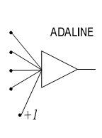
ADAPTIVE LINEAR NEURON (ADALINE)
In 1959, Bernard Widrow and Marcian Hoff of Stanford developed models they called ADALINE (Adaptive Linear Neuron) and MADALINE (Multilayer ADALINE). These models were named for their use of Multiple ADAptive LINear Elements. MADALINE was the first neural network to be applied to a real world problem. It is an adaptive filter which eliminates echoes on phone lines.
Computer Science and Engineering, VJCET, Vazhakulam

Slide 36
ADAPTIVE LINEAR NEURON (ADALINE)
The units with linear activation functions are called linear units
A network with a single linear unit is called an Adaline
ie, In Adaline input output relationship is linear
Adaline uses the bipolar activation for its input signal and its target output
The weight between the input and output are adjustable
The bias in Adaline act like an adjustable weight whose connection is from a unit with activation being always 1
Adaline is a net which has only one output unit
Trained using delta rule
This rule is found to minimize the mean squared error between the activation and target value
Computer Science and Engineering, VJCET, Vazhakulam

Slide 37
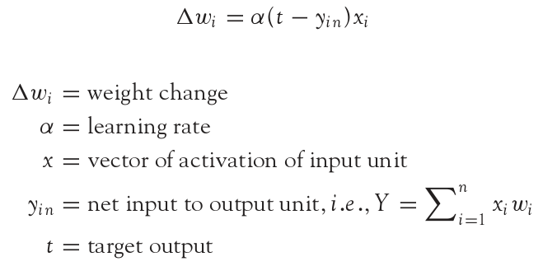
ADALINE LEARNING RULE
Adaline network uses Delta Learning Rule. This rule is also called as Widrow-Hoff Learning Rule or Least Mean Square Rule. The delta rule for adjusting the weights is given as (i = 1 to n):
Computer Science and Engineering, VJCET, Vazhakulam

Slide 38
ADALINE LEARNING RULE
Similar to Perceptron rule
Perceptron rule is originated from Hebbian Assumption
Delta rule is from Gradient Descent method
Perceptron rule stops after a finite number of learning steps
Delta rule continues forever, converging only asymptotically to the solution
Delta rule update the weight between the connection so as to minimize the difference between the net input to the output unit and the target value
Major aim is to minimize the error over all training patterns
Perceptron | Delta
Originates from hebbian assumption | Derived from gradient-descent method
Stops after a finite number of learning steps | Continuous forever converging asymptotically to the solution
 | Minimizes error over all training patterns
Computer Science and Engineering, VJCET, Vazhakulam

Slide 39
Architecture
Adaline is a single unit neuron, which receives the input from several units and also from units called bias
Basic Adaline model consist of trainable weights
Input are either of 2 values(+1 or -1) and the weight have signs(positive or negative)
Initially random weights are assigned
The net input is calculated is applied to a quantizer transfer function that restore the output to +1 or -1
Adaline model compare the actual output with the target output and on the basis of training algorithm, the weights are adjusted
Computer Science and Engineering, VJCET, Vazhakulam

Slide 40
Architecture
Computer Science and Engineering, VJCET, Vazhakulam
x0=1
1
x1
b
X1
w1
w2
Y_{in} = ∑ xiwi
f(yin)
x2
∑
X2
wn
y_{in}
xn
Xn
Learning supervisor
e=t-y_{in}
Output error
generator
t
Adaptive
algorithm

Slide 41
USING ADALINE NETWORKS
Initialize
Assign random weights to all links
Training
  Feed-in known inputs in random sequence
  Simulate the network
  Compute error between the input and the output (Error Function)
  Adjust weights (Learning Function)
  Repeat until total error < ε
Thinking
  Simulate the network
  Network will respond to any input
  Does not guarantee a correct solution even for trained inputs
Initialize
Training
Thinking
Computer Science and Engineering, VJCET, Vazhakulam

Slide 42
TRAINING ALGORITHM
Computer Science and Engineering, VJCET, Vazhakulam

Slide 43
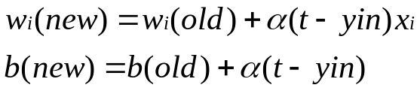
Start
Computer Science and Engineering, VJCET, Vazhakulam
Stop
Initialize weights and bias and α
YES
If Ei=Es
NO
Input the specified tolerance error Es
Calculate error
Ei=Σ(t-yin)2
For each s:t
NO
YES
Activate input units
Xi=si
Calculate net input
Yin=b+Σxi wi

Slide 44
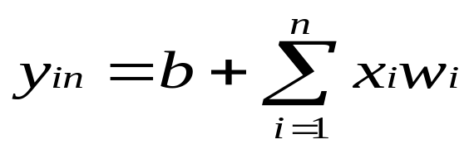
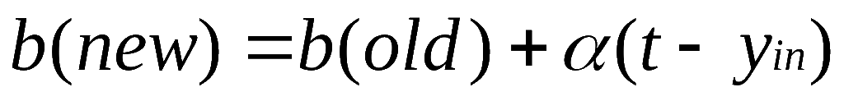
Adaline Training Algorithm
Step 0: Weights and bias are set to some random values other than zero. Learning rate α is set
Step 1: Perform Steps 2-6 when stopping condition is false.
Step 2: Perform steps 3-5 for each bipolar training pair s:t
Step 3: Set activations for input units i=1 to n xi=si
Step 4: Calculate the net input to the output unit
Step 5: Update the weights and bias for i=1 to n
Step 6: If highest weight change that occurred during training is smaller than a specified tolerance then stop the training else continue. (Stopping condition)
Computer Science and Engineering, VJCET, Vazhakulam

Slide 45

Testing Algorithm
Step 0: Initialize the weights(from training algo)
Step 1: Perform steps2-4 for each bipolar input vector x
Step 2: Set the activations of the input units to x
Step 3: Calculate the net input
Step 4: Apply the activation function over the net input calculated
y =
1 If y_{in} >= 0
-1 If y_{in} < 0
Computer Science and Engineering, VJCET, Vazhakulam

Slide 46
TUTORIAL QUESTIONS

Slide 47
Use ADALINE network to train ANDNOT function with bipolar input and targets. Perform 2 epoch of training
Implement AND function using ADALINE
Using Delta rule find the weight required to perform following classifications: Vectors(1,1,-1,-1) and (-1,-1,-1,-1) belongs to the class having target value 1: vectors (1,1,1,1) and (-1,-1,1,-1) re not belong to the class having target value -1.Use learning rate of 0.5 and assume random values weight. Also test the network

Slide 48
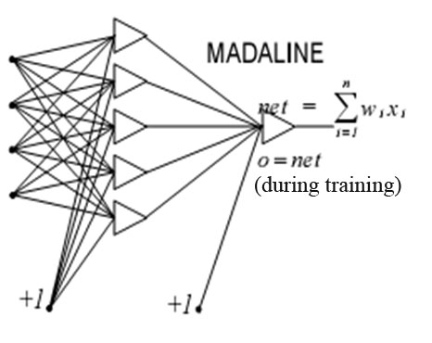
MADALINE NETWORK
MADALINE is a Multilayer Adaptive Linear Element. MADALINE was the first neural network to be applied to a real world problem. It is used in several adaptive filtering process.
Computer Science and Engineering, VJCET, Vazhakulam

Slide 49
Madaline
Two or more adaline are integrated to develop madaline model
Used for nonlinearly separable logic functions (X-OR) function
Used for adaptive noise cancellation and adaptive inverse control
In noise cancellation the objective is to filter out an interference component by identifying a linear model of a measurable noise source and the corresponding immeasurable interference.
ECG, echo elimination from long distance telephone transmission lines
Computer Science and Engineering, VJCET, Vazhakulam

Slide 50
ARCHITECTURE
Simple madaline architecture consist of ‘n’ unit of input layer ‘k’ unit of Adaline layer and one unit of madaline layer
Each neuron in the adaline and madaline layer has a bias of excitation 1
Adaline layer is present between the input layer and madaline layer hence the adaline layer can be considered as hidden layer
The use of hidden layer gives the net computational capability which is not found in single layer net
But this complicate the training process
Computer Science and Engineering, VJCET, Vazhakulam

Slide 51
1
b1
x1
X1
w11
Z1
V1
w1j
1
w1m
1j
wi1
b0
bj
xi
wij
Vj
Xi
Zj
Y
wim
1m
Vm
wn1
wnj
bm
wnm
Zm
xn
Xn
Computer Science and Engineering, VJCET, Vazhakulam

Slide 52
TRAINING ALGORITHM
Computer Science and Engineering, VJCET, Vazhakulam

Slide 53
START
YES
If t=y
Intial & fixed weight and bias
Set α (0 to 1)
C
No
For Each s:t
No
B
If t=1
No
YES
Activate input unit xi=si
YES
Update weight on unit z_{j} whose net input is closest to zero
b_{j}(new)=b_{j}(old)+α(1-z_{inj})
w_{ij}=w_{ij}(old)+ α(1-z_{inj}) x_{i}
Update weight on unit z_{k} which has positive net input
b_{k}(new)=b_{k}(old)+α(1-z_{ink})
w_{ik}=w_{ik}(old)+ α(1-z_{ink}) x_{i}
Find net input to hidden layer
z_{in j =} b_{j +} ∑ x_{i}w_{ij}
Calculate the output
Z_{j=}f(z_{in j} )
If no weight changes or specified number of epochs
Calculate net input to output unit
Y_{in} = b0+ ∑ z_{j}v_{j}
No
C
Calculate output y=f(y_{in} )
YES
B
Computer Science and Engineering, VJCET, Vazhakulam
STOP

Slide 54
Only the weight between the hidden layer and input layer are adjusted
Weight for the output layer is fixed
The weight v1,v2,v3 .... vj and bias b0 that enter into the output unit Y are delimited so that the response of unit Y is 1
Thus the weight entering the Y unit may be taken as
  v1 = v2 = … vj = ½
Bias can be taken as
b0=1/2
The activation function of adaline and madaline unit are
f(x)=
1 If x >= 0
-1 If x < 0
Computer Science and Engineering, VJCET, Vazhakulam

Slide 55
Step 0: Initialize the weight. The weight entering the output unit are set. Set initial small random values for adaline weights. Also set initial learning rate α
Step 1 : When stopping condition is false, perform step 2-3
Step 2: For each bipolar training pair s:t, perform 3-7
Step 3: Activate input layer unit. For i=1 to n xi=si
Step 4: Calculate the net input unit to each hidden adaline unit
z_{in j =} b_{j +} ∑ x_{i}w_{ij ,j= 1 to m}
Step 5: Find output of each hidden unit
Z_{j=}f(z_{in j} )
Step 6: Find output of net
Y_{in} = b0+ ∑ z_{j}v_{j}
y=f(y_{in} )
Computer Science and Engineering, VJCET, Vazhakulam

Slide 56
Step 7: Calculate the error and update the weight
  A: if t=y , no weight updation is required
  B: if t!=y , & t= +1 update weight on zj where net input closer to zero
b_{j}(new)=b_{j}(old)+α(1-z_{inj})
w_{ij}=w_{ij}(old)+ α(1-z_{inj}) x_{i}
  C: if t!=y and t =-1 update the weight on unit zk whose net input is positive
b_{k}(new)=b_{k}(old)+α(1-z_{ink})
w_{ik}=w_{ik}(old)+ α(1-z_{ink}) x_{i}
Step 8: Test for stopping condition (if there is no weight change or weight reaches the satisfactory level, or if a specified maximum number of weight updation have been performed then stop or else continue
Computer Science and Engineering, VJCET, Vazhakulam

Slide 57
A training procedure which allows multilayer feed forward Neural Networks to be trained.
Can theoretically perform “any” input-output mapping.
Can learn to solve linearly inseparable problems.
Computer Science and Engineering, VJCET, Vazhakulam

Slide 58
MULTILAYER FEEDFORWARD NETWORK
Inputs
Hiddens
I₀
Outputs
h₀
I₁
o₀
h₁
I₂
o₁
h₂
Outputs
I₃
Hiddens
Inputs
Computer Science and Engineering, VJCET, Vazhakulam

Slide 59
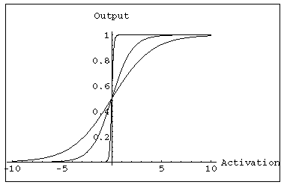
MULTILAYER FEEDFORWARD NETWORK:
ACTIVATION AND TRAINING
For feed forward networks:
  A continuous function can be
  differentiated allowing
  gradient-descent.
  Back propagation is an example of a gradient-descent technique.
  Uses sigmoid (binary or bipolar) activation function.
Computer Science and Engineering, VJCET, Vazhakulam

Slide 60
In multilayer networks, the activation function is
usually more complex than just a threshold function,
like 1/[1+exp(-x)] or even 2/[1+exp(-x)] – 1 to allow for
inhibition, etc.
Computer Science and Engineering, VJCET, Vazhakulam

Slide 61
GRADIENT DESCENT
Gradient-Descent(training_examples, η)
Each training example is a pair of the form <(x₁,…x_{n}),t> where (x₁,…,x_{n}) is the vector of input values, and t is the target output value, η is the learning rate (e.g. 0.1)
Initialize each wi to some small random value
Until the termination condition is met, Do
  Initialize each Δwi to zero
  For each <(x₁,…x_{n}),t> in training_examples Do
Computer Science and Engineering, VJCET, Vazhakulam

Slide 62
    Input the instance (x1,…,xn) to the linear unit and compute the output o
    For each linear unit weight wi Do
  Δw_{i}= Δw_{i} + η (t-o) xi
  For each linear unit weight wi Do
  w_{i}=w_{i}+Δw_{i}
Computer Science and Engineering, VJCET, Vazhakulam

Slide 63
MODES OF GRADIENT DESCENT
Batch mode : gradient descent
w=w - η ∇ED[w] over the entire data D
ED[w]=1/2Σd(t_{d}-o_{d})2
Incremental mode: gradient descent
w=w - η ∇E_{d}[w] over individual training examples d
Ed[w]=1/2 (t_{d}-o_{d})2
Incremental Gradient Descent can approximate Batch Gradient Descent arbitrarily closely if η is small enough.
Computer Science and Engineering, VJCET, Vazhakulam

Slide 64
SIGMOID ACTIVATION FUNCTION
x₀₌₁
x₁
w₁
w₀
net=Σ_{i=0}^{n} w_{i} x_{i}
o=σ(net)=1/(1+e^{-net})
w₂
x₂
Σ
o
.
.
.
w_{n}
σ(x) is the sigmoid function: 1/(1+e-x)
dσ(x)/dx= σ(x) (1- σ(x))
x_{n}
Derive gradient decent rules to train:
one sigmoid function
∂E/∂w_{i} = -Σd(td-od) od (1-od) xi
Multilayer networks of sigmoid units backpropagation
Computer Science and Engineering, VJCET, Vazhakulam

Slide 65
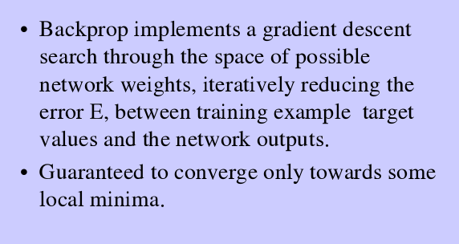
BACK PROPAGATION NETWORK
Computer Science and Engineering, VJCET, Vazhakulam

Slide 66
BACKPROPAGATION
Gradient descent over entire network weight vector
Easily generalized to arbitrary directed graphs
Will find a local, not necessarily global error minimum -in practice often works well (can be invoked multiple times with different initial weights)
Often include weight momentum term
      Δwi,j(t)= η δj xi,j + α Δwi,j (t-1)
Minimizes error training examples
  Will it generalize well to unseen instances (over-fitting)?
Training can be slow typical 1000-10000 iterations (use Levenberg-Marquardt instead of gradient descent)
Computer Science and Engineering, VJCET, Vazhakulam

Slide 67
Back propagation is a training method used for a multi layer feed forward network.
The network associated with Back propagation learning algorithm is called BACK PROPAGATION NETWORK
Processing elements with continuous differentiable activation functions
It is also called the generalized delta rule.
It is a gradient descent method which minimizes the total squared error of the output computed by the net.
Any neural network is expected to respond correctly to the input patterns that are used for training which is termed as memorization and it should respond reasonably to input that is similar to but not the same as the samples used for training which is called generalization.
Computer Science and Engineering, VJCET, Vazhakulam

Slide 68
The training of a neural network by back propagation takes place in three stages
  1. Feed forward of the input pattern
  2. Calculation and Back propagation of the associated error
  3. Adjustments of the weights
After the neural network is trained, the neural network has to compute the feed forward phase only.
Even if the training is slow, the trained net can produce its output immediately.
Computer Science and Engineering, VJCET, Vazhakulam

Slide 69
ARCHITECTURE
The output units and the hidden units can have biases.
These bias terms are like weights on connections from units whose output is always 1.
During feed forward the signals flow in the forward direction i.e. from input unit to hidden unit and finally to the output unit.
During back propagation phase of learning, the signals flow in the reverse direction.
Computer Science and Engineering, VJCET, Vazhakulam

Slide 70
1
1
x1
t1
X1
Z1
Y1
Y1
xi
tk
Xi
Zj
YK
YK
tp
Zm
YP
xn
YP
Xn
Computer Science and Engineering, VJCET, Vazhakulam

Slide 71
Algorithm
The training involves three stages
  1. Feed forward of the input training pattern
  2. Back propagation of the associated error
  3. Adjustments of the weights.
During feed forward, each input unit (Xi) receives an input signal and sends this signal to each of the hidden units Z1, Z2, …Zn.
Each hidden unit computes its activation and sends its signal to each output unit.
Each output unit computes its activation to compute the output or the response of the neural net for the given input pattern.
Computer Science and Engineering, VJCET, Vazhakulam

Slide 72
During training, each output unit compares its computed activation yk, with its target value tk to determine the associated error for the particular pattern.
Based on this error the factor δk for all m values are computed.
This computed δ k is used to propagate the error at the output unit Yk back to all units in the hidden layer.
At a later stage it is also used for updation of weights between the output and the hidden layer.
In the same way δj for all p values are computed for each hidden unit Zj.
The values of δj are not sent back to the input units but are used to update the weights between the hidden layer and the input layer.
Computer Science and Engineering, VJCET, Vazhakulam

Slide 73
Once all the ∂ factrs are known, the weights for all laye rs are changed simultaneously.
The adjustment to all weights wjk is based on the factor ∂k and the activation zj of the hidden unit Zj.
The change in weight to the connection between the input layer and the hidden layer is based on ∂j and the activation xi of the input unit
Computer Science and Engineering, VJCET, Vazhakulam

Slide 74




start
Compute error correlation factor between o/p& hidden
δ_{k}=(t_{k}-y_{k})f’ (y_{ink})
Initialize weights to some random values
C
Find weight and bias correction term
Δw_{jk}=αδ _{k}z_{j} , Δw_{ok}=αδ _{k}
For each training pair x, t
Calculate error term δ _{j} b/w hidden & input
B
Compute change in weight & bias based on δ _{j}
Δv_{ij}=αδ _{j} x_{i} Δv_{oj}=αδ _{j}
Receive input signal xi & transmit to hidden unit
Update weight and bias on output unit
In hidden unit calculate o/p
Z_{inj} =v_{oj}+∑ x_{i}v_{ij}
Z_{i}=f(z_{inj})
Update weight and bias on hidden unit
Send zj to output layer unit
No
If specified no of epochs reaches or tk=yk
Calculate o/p signal from o/p layer
Y_{ink}=w_{ok}+ ∑ z_{i}w_{jk}
Y_{k}=f(y_{ink})
C
Target pair tk enters
Yes
B
Computer Science and Engineering, VJCET, Vazhakulam
Stop

Slide 75
Activation Function
An activation function for a back propagation net should have important characteristics.
It should be continuous, Differentiable and monotonically non- decreasing.
For computational efficiency, it is better if the derivative is easy to calculate.
For the commonly used activation function, the derivative can be expressed in terms of the value of the function itself. The function is expected to saturate asymptotically.
The commonly used activation function is the binary sigmoidal function.
Computer Science and Engineering, VJCET, Vazhakulam

Slide 76
Training Algorithm
The activation function used for a back propagation neural network can be either a bipolar sigmoid or a binary sigmoid.
The form of data plays an important role in choosing the type of the activation function.
Because of the relationship between the value of the function and its derivative, additional evaluations of exponential functions are not required to be computed.
Computer Science and Engineering, VJCET, Vazhakulam

Slide 77
Step 0: Initialize weights
Step 1: While stopping condition is false, do steps 2 to 9
Step 2: For each training pair, do steps 3 - 8
Feed forward
  Step 3: Input unit receives input signal and propagates it to all units in the hidden layer
  Step 4: Each hidden unit sums its weighted input signals
  Step 5: Each output unit sums its weighted input signals and applied its activation function to compute its output signal.
Computer Science and Engineering, VJCET, Vazhakulam

Slide 78


Back propagation
  Step 6: Each output unit receives a target pattern corresponding to the input training pattern, computes its error information term
  δ_{k} = ( t_{k} – y_{k}) f’ (y__{ink})
  Calculates its bias correction term
  ∆Wok = αδk
  And sends δk to units in the layer below
Step 7: Each hidden unit sums its delta inputs
Multiplies by the derivative of its activation function to calculate its error information term
Calculates its weight correction term
And calculates its bias correction term
Computer Science and Engineering, VJCET, Vazhakulam

Slide 79
Update weights and biases
Step 8: Each output unit updates its bias and weights
Each hidden unit updates its bias and weights
Step 9: Test stopping condition. The stopping condition may be certain number of epochs reached or when the actual output equal to target value
Computer Science and Engineering, VJCET, Vazhakulam

Slide 80
The above algo uses the incremental approach for updation of weight
That is weights are being changed immediately after a training pattern is present
There is another way of training called batch mode training where the weights are changed only after all the training pattern are presented
Batch mode requires additional local storage for each connection to maintain the immediate weight change
When a BPN used as a classifier, it is equivalent to the optimal Bayesian Descriminator function for assymptotically large set of training patterns
Computer Science and Engineering, VJCET, Vazhakulam

Slide 81
If the BPN algorithm converges at all , then it may get stuck with local minima and may be unable to find a satisfactory solution
The randomness of the algorithm helps it to get out of local minima
The error function may have large number of global minima because of permutation of weight that keep the network input output function unchanged
Computer Science and Engineering, VJCET, Vazhakulam

Slide 82
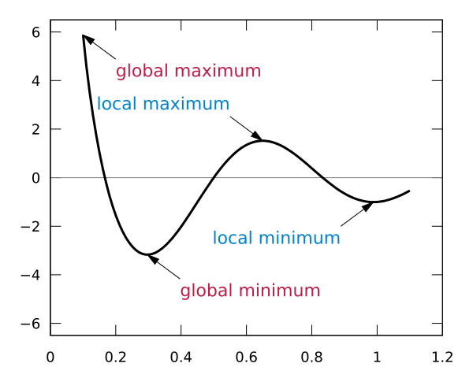

Slide 83
LEARNING FACTORS OF BACK PROPOGATION NETWORK
Training of BPN is based on the choice of various parameters
Convergence of BPN is based on some important learning factors such as
  Initial weight
  The learning rate
  The updation rule
  Size and nature of training set
  Architecture (number of layers and number of neurons in each layer

Slide 84
INITIAL WEIGHT
The weights are initialized with some random values
The choice of initial weight is determines how fast the network converges
The initial weight cannot be very high becoz sigmoid activation function used here may get saturated from the beginning itself and the system may be stuck at the local minima
One method for choosing weight is in the range
Where oi is the number of processing elements j that feed forward to processing element i
[ -3/√o_{i,} 3/√oi ]

Slide 85
The initialization can also be done by a method called Nguyen- Widrow Initialization
Leads to faster convergence of network
Improves the learning ability of hidden layer
The random initialization of weight connecting input neuron to the hidden neuron is obtained by
Vij (new)=γ vij(0ld)/ || vj(old)||

Slide 86
LEARNING RATE α
Affect the convergence of BPN
A large value of alpha may speedup the convergence but may result in overshooting
The range of alpha from 10^-3 to 10 has been used successfully for several backpropogation algorithms experiments
Slower learning rate lead to slower learning

Slide 87
Momentum factor
The gradient descent is very slow if the learning rate is small and oscillate widely if alpha is too large
One method that allows a large learning rate without oscillation is by adding a momentum factor to the normal gradient descent method

Slide 88
GENERALIZATION
A network is said to be generalized when it sensibly interpolate with input network that are new to the network
When there are many trainable parameters for a given amount of training data, the network learn well but does not generalize well
This is usually called over fitting or over training
One solution is to monitor error on the test set and terminate the training when error increases
With a small number of trainable parameters, the network fail to learn training data set to test the data set
However computationally large number of nodes is capable of memorizing the training set at the cost of generalization
As a result smaller net are preferred than larger ones

Slide 89
Number of Training Data
Training data should be sufficient and proper
There exist a rule of thumb which state that the training data should cover the entire expected input space, and while training , the training vector pair should be selected randomly from the set

Slide 90
Number of Hidden Layer nodes
If there exist more than one hidden layer in BPN, then the calculation performed for a single layer are repeated for all the layers and summed up at the end
In case of all multilayer feed forward network, the size of hidden layer is very important
The number of hidden layer need for an application determined separately
The size of hidden layer is determined experimentally
For a network of reasonable size, the size of hidden layer has only be a relatively small fraction of input layer
For example if the network does not converges to a solution , it may need more hidden layers

Slide 91
Testing Algorithm
Step 0: Initialize weight. The weight are taken from training algorithm
Step 1: Perform step 2- 4 for each input vector
Step 2: Set the activation of input unit for xi
Step 3: Calculate the net input to hidden unit and its output
Step 4: Now compute the output for output layer unit. Use sigmoidal activation function

Slide 92
-0.2
Y1
=0.25
t=1
0.4
0.1
0.3
Z1
Z2
0.5
-0.1
-0.3
0.6
0.4
X1
X2
0
1
Computer Science and Engineering, VJCET, Vazhakulam

Slide 93
-0.2
Y1
=0.25
t=1
0.4
0.1
0.3
Z1
Z2
0.5
-0.1
-0.3
0.6
0.4
X1
X2
-1
1
Computer Science and Engineering, VJCET, Vazhakulam

Slide 94
-0.4
Y1
=0.3
t=1
0.3
0.2
0.2
Z1
Z2
0.4
-0.1
-0.6
0.5
0.7
X1
X2
1
0
Computer Science and Engineering, VJCET, Vazhakulam

Slide 95
-0.4
Y1
=0.3
t=1
0.3
0.2
0.2
Z1
Z2
0.4
-0.1
-0.6
0.5
0.7
X1
X2
1
-1
Computer Science and Engineering, VJCET, Vazhakulam

Slide 96
-0.4
Y1
=0.45
t=-1
0.3
0.2
0.2
Z1
Z2
0.4
-0.1
-0.6
0.5
0.7
X1
X2
-1
1
Computer Science and Engineering, VJCET, Vazhakulam

Slide 97
APPLICATIONS OF BACKPROPAGATION
NETWORK
Load forecasting problems in power systems.
Image processing.
Fault diagnosis and fault detection.
Gesture recognition, speech recognition.
Signature verification.
Bioinformatics.
Structural engineering design (civil).
Computer Science and Engineering, VJCET, Vazhakulam

